Slide 1
Frighten & Forget?
A glimpse of mechanisms of stress and memory
Jason Gale
Notes:
Instead of forgive

Slide 2
PTSD
mental disorder
Orexin
neuropeptide
TNF
cytokine

Slide 3
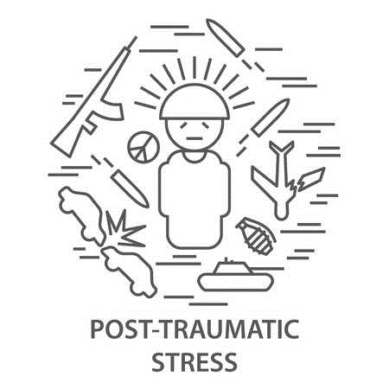
Posttraumatic Stress Disorder (PTSD)
DSM-V: Trauma- and Stressor-Related Disorder
Traumatic event – death, near-death, injury, violence
Direct experience
Witnessed
Learning about – someone else
Repeated/extreme exposure
Unpleasant details
Trauma: 60% men, 50% women
7-8% lifetime prevalence
4% men, 10% women (U.S.)
Notes:
prevalence

Slide 4
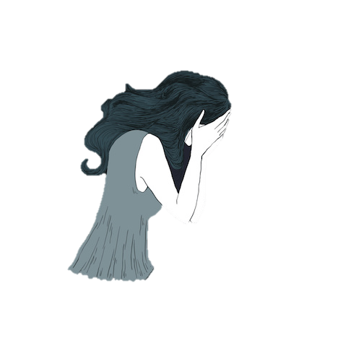
Posttraumatic Stress Disorder (PTSD)
Intrusion symptoms
Memories
Dreams
Flashbacks
Reaction to Cues
psychological, physiological
Notes:
Cues – internal or external

Slide 5
Posttraumatic Stress Disorder (PTSD)
Negative thoughts/feelings
Dissociative amnesia (blocking out)
Negative beliefs – self, world
Negative emotional state
Lack of interest in activities
Detachment from others
Unable to experience positive emotions
Avoidance: memories, thoughts, feelings

Slide 6
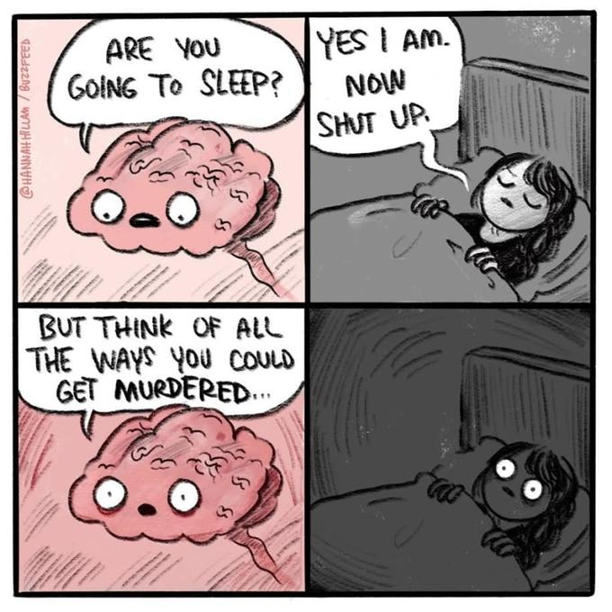
Posttraumatic Stress Disorder (PTSD)
Reactions to event
Irritability / angry outbursts
Recklessness
Heightened awareness of danger
Easily startled
Concentration problems
Sleep problems – falling/staying/restless

Slide 7
PTSD
Intrusion symptoms:
Memories
Dreams
Flashbacks
Reaction to Cues
Reactions to event:
Concentration problems
Sleep problems
Notes:
A lot of these relate to memory somehow

Slide 8
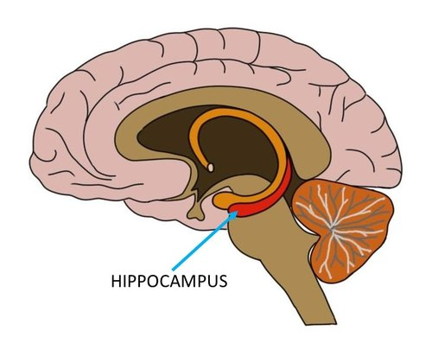
Hippocampus
Declarative Memory
Formation & conscious retrieval
Spatial memory
Environmental info, navigation
Fear memory – also nondeclarative
Conditioned to fearful stimuli
Recognition memory
Recollection & familiarity
Notes:
Recollection – action; familiarity - feeling

Slide 9
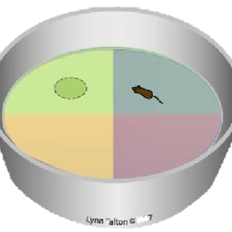
Morris Water Maze (MWM)
Spatial learning & memory
Circular pool
Two parts
Place navigation test
learning
Spatial probe test
memory

Slide 10
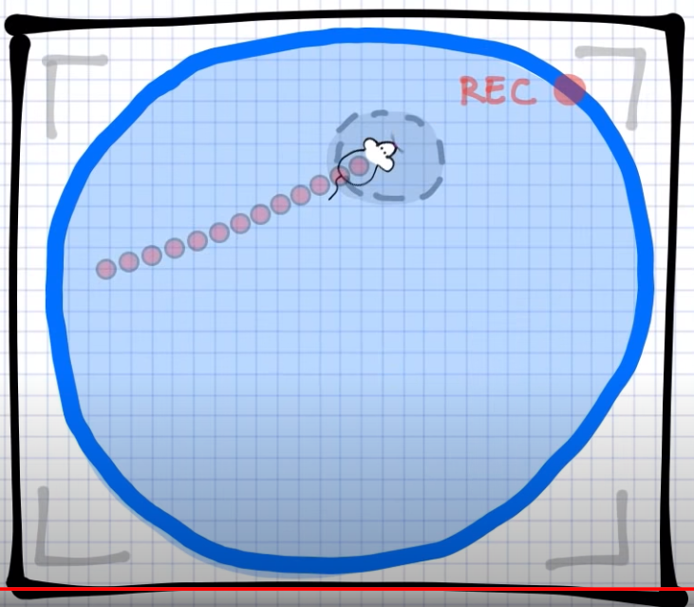
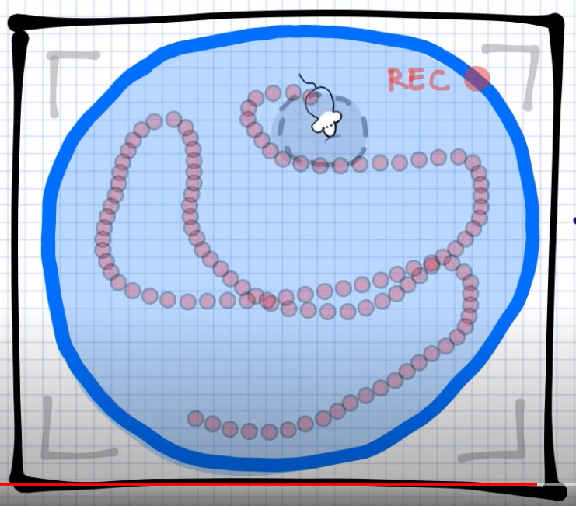
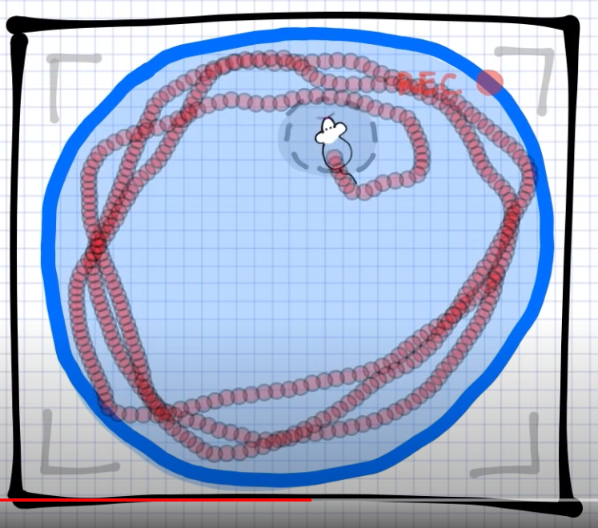
Morris Water Maze (MWM)
Place Navigation Test (PNT)
Multiple
Hidden platform
Finds platform
“escape latency”

Slide 11
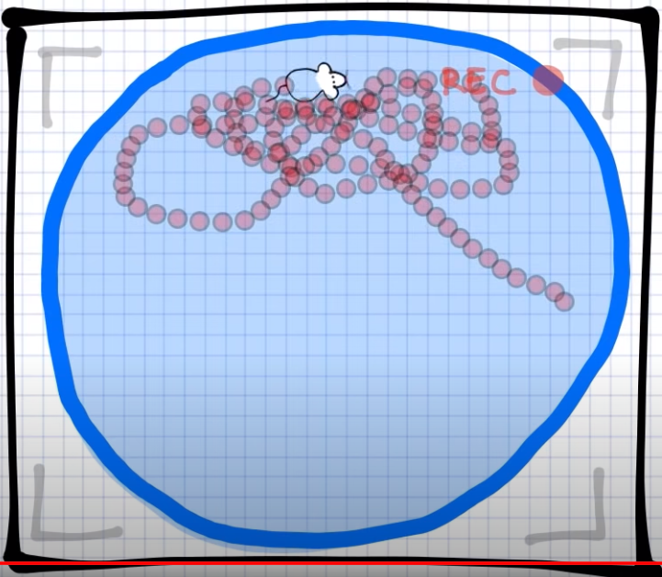
Morris Water Maze (MWM)
Spatial Probe Test (SPT)
Once
Platform removed
Swims where platform was
“platform crossings”

Slide 12
Single Prolonged Stress (SPS)
Model for PTSD – negative feedback on HPA axis

Slide 13
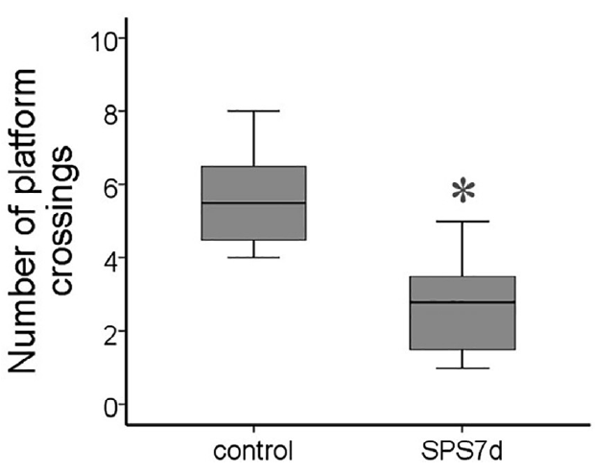
PTSD (SPS) & Memory (MWM)
Stress impairs memory
Effect 7d after stress
Notes:
spatial

Slide 14
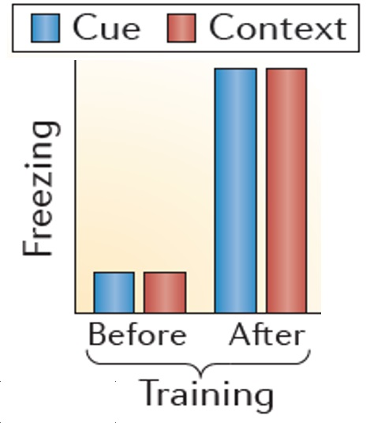
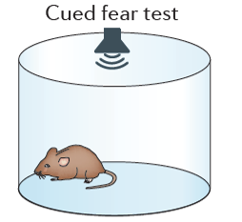
Foot Shock (FS) Fear Conditioning
Model for PTSD

Slide 15
Foot Shock (FS) Fear Conditioning
Re-exposure (no, 3min, 30min)
Behavior Eval. (5min)
24h
Foot Shock or not
24h
Notes:
3-day paradigm: behavioral results taken on day 3

Slide 16
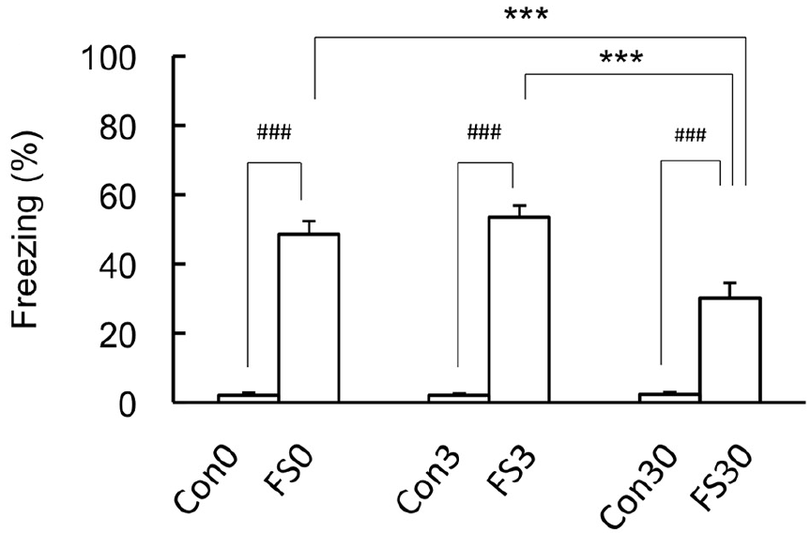
Foot Shock (FS) Fear Conditioning
Re-exposure Time
Fear Retention: 0min, 3min
Fear Extinction: 30min
Notes:
stress (FS) increased freezing (Fig. 1A)
Con0 < FS0, Con3 < FS3, Con30 < FS30
long-duration re-exposure decreased freezing (Fig. 1A)
FS30 < FS3, FS30 < F0

Slide 17
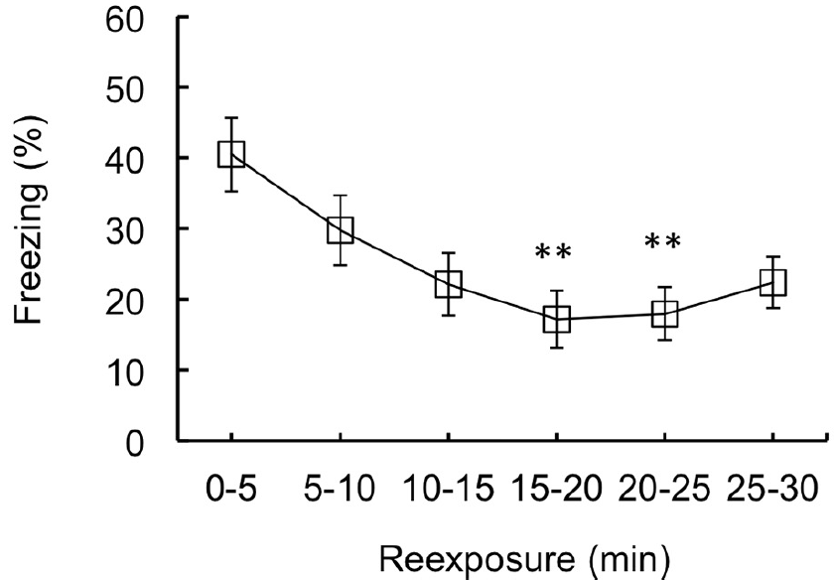
Foot Shock (FS) Fear Conditioning
Fear extinction
Decreased freezing
over time
Notes:
longer re-exposure time decreased freezing after stress (FS) (Fig. 1B)
0-5min > 15-20min, 0-5min > 15-20min

Slide 18
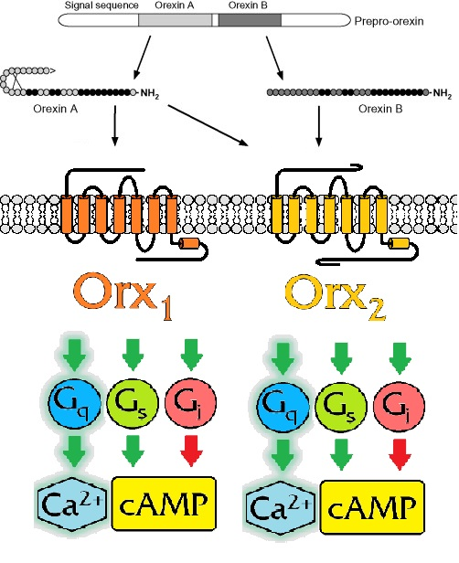
Orexin/Hypocretin (Orx/Hcrt)
Neuropeptide/neurohormone
Prepro-orexin (prepro-hypocretin)
Orexin A (Hypocretin 1)
Orexin B (Hypocretin 2)
G protein-coupled receptors
discovered first – orphan
Orexin 1 (Hypocretin receptor 1)
Orexin 2 (Hypocretin receptor 2)

Slide 19
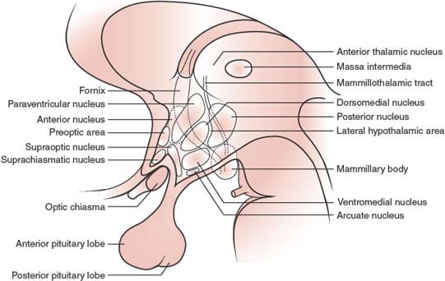
Orexin/Hypocretin (Orx/Hcrt)
Produced in hypothalamus – begins
Perifornical (PeF)
Dorsomedial (DMH)
Posterior (PH)
Lateral (LH)

Slide 20
Orexin/Hypocretin (Orx/Hcrt)
Involved in
Stress
Motivation
Feeding
Learning & Memory
Alertness
Sleep

Slide 21
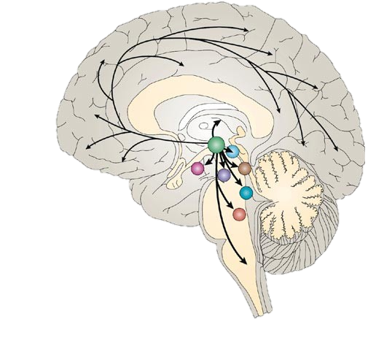
Orexin/Hypocretin (Orx/Hcrt)
Involved in
Stress
Motivation
Feeding
Learning & Memory
Alertness
Sleep
Notes:
How it’s able to have so many actions – many connections

Slide 22
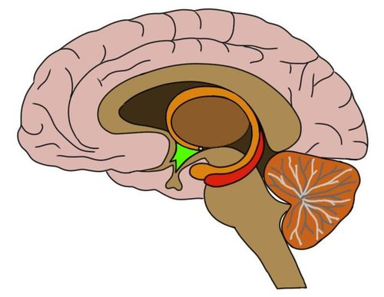
Hypothalamus
Multiple areas (nuclei)
Various functions
Homeostasis – balance
Hormones
Release and signal
Pituitary

Slide 23
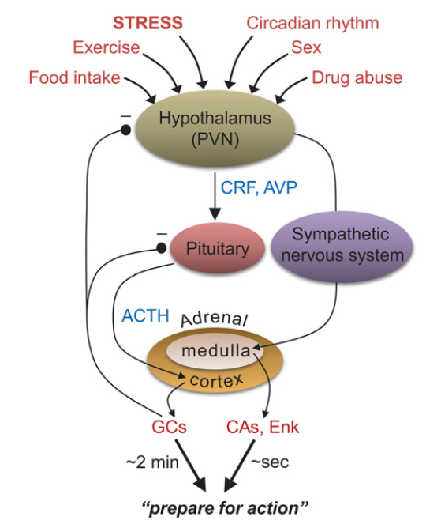
Hypothalamus
H
P
A
Multiple areas (nuclei)
Various functions
Homeostasis – balance
Hormones
Release and signal
Pituitary
HPA axis

Slide 24
PTSD
Orx
Intrusion symptoms:
Memories
Dreams
Flashbacks
Reaction to Cues
Reactions to event:
Concentration problems
Sleep problems
Involved in:
Stress
Feeding
Learning & Memory
Sleep

Slide 25
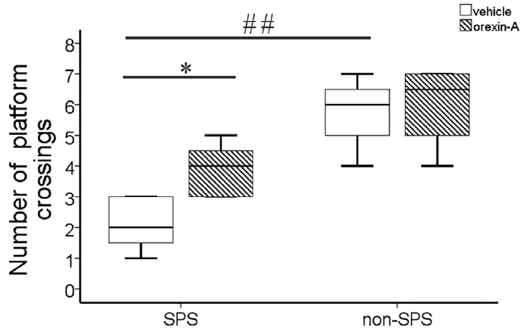
PTSD and Orexin
Stress impairs memory
How?
Notes:
stress (SPS) decreased number of platform crossing (MWM) (Fig. 6C##)
SPS+Veh < non-SPS+Veh
icvOrxA increased number of platform crossings (MWM) after stress (SPS) (Fig. 6C*)
SPS+Veh < SPS+OrxA

Slide 26
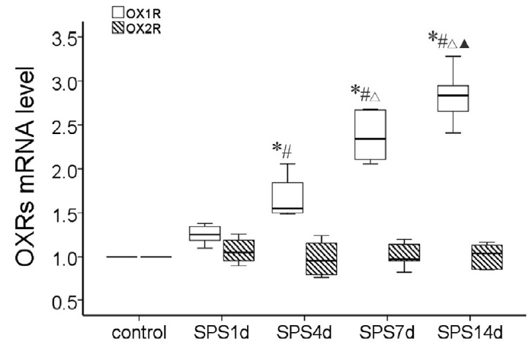
PTSD and Orexin
Orx₁ is upregulated after intense stress
Hypothalamus
mRNA & protein
Gradual effect
Notes:
stress (SPS) increased Orx1 mRNA in hypothalamus (Fig. 4D)
non-SPS = 1d later < 4d later < 7d later < 14d later

Slide 27
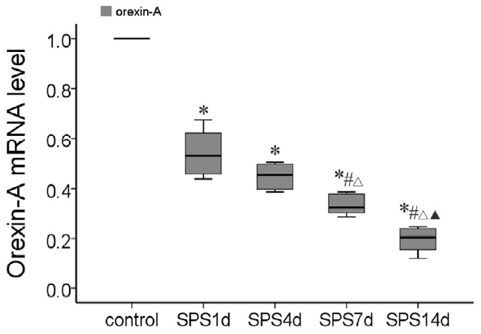
PTSD and Orexin
Stress reduces Orx_{A} mRNA
Hypothalamus
Gradual effect
Notes:
stress (SPS) decreased OrxA mRNA in hypothalamus (Fig. 4C)
non-SPS > 1d later = 4d later > 7d later > 14d later

Slide 28
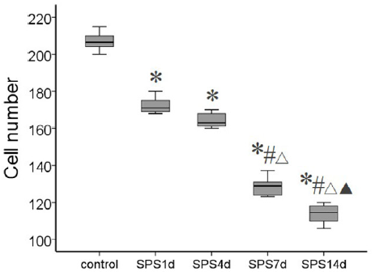
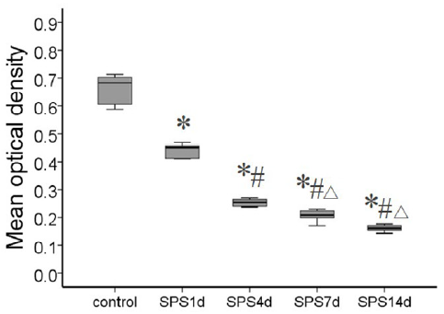
PTSD and Orexin
Gradual effect – hypothalamus cells with Orx_{A}
Notes:
stress (SPS) caused lower amount of OrxA in LH cells (Fig. 3G)
non-SPS > 1d later > 4d later > 7d later = 14d later
stress (SPS) caused fewer number of cells with orexin-A in them in LH (Fig. 3H)
non-SPS > 1d later > 4d later > 7d later > 14d later

Slide 29
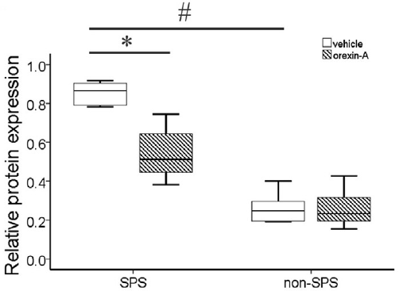
PTSD and Orexin
Orx_{A} effects oppose stress effects
Orx₁ decrease
Hypothalamus
Orx₁
Notes:
stress (SPS) increased Orx1 protein in hypothalamus (Fig. 7B#)
SPS+Veh > non-SPS+Veh
icvOrxA decreased Orx1 protein in hypothalamus after stress (SPS) (Fig. 7B*)
SPS+Veh > SPS+OrxA

Slide 30
PTSD and Orexin
Hypothalamus
PTSD: ↓Orx_{A}
↑Orx₁ not Orx₂
Different roles?
↑Orx_{A}: ↓Orx₁
Hippocampus
?

Slide 31
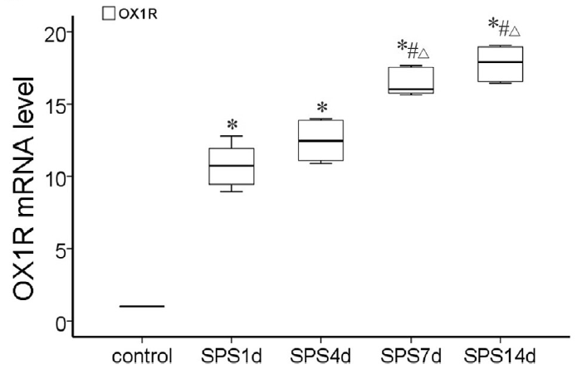
PTSD and Orexin
Orx₁ & Orx₂ are upregulated after stress
Hippocampus
mRNA & protein
Gradual effect
Notes:
stress (SPS) increased Orx1 mRNA in hippocampus (Fig. 5C)
non-SPS < 1d later = 4d later < 7d later < 14d later

Slide 32
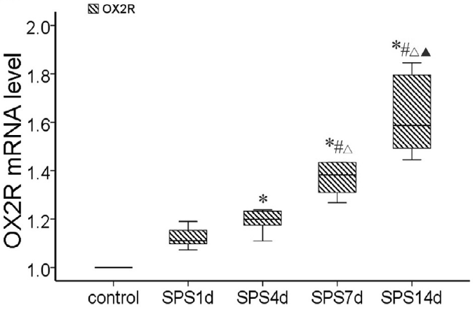
PTSD and Orexin
Orx₁ & Orx₂ are upregulated after stress
Hippocampus
mRNA & protein
Gradual effect
Notes:
stress (SPS) increased Orx2 mRNA in hippocampus (Fig. 5D)
non-SPS = 1d later < 4d later < 7d later < 14d later

Slide 33
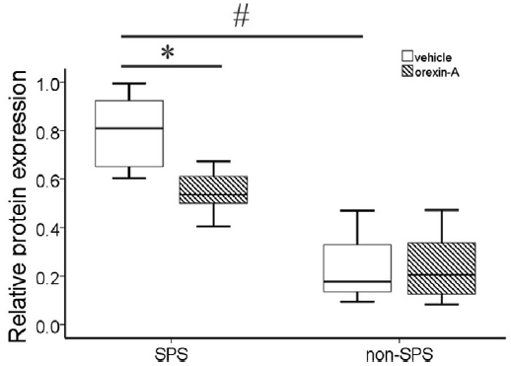
PTSD and Orexin
Orx_{A} effects oppose stress effects
Orx₁ decrease
Hippocampus
Orx₁
Notes:
stress (SPS) increased Orx1 protein in hippocampus (Fig. 7E#)
SPS+Veh > non-SPS+Veh
icvOrxA decreased Orx1 protein in hippocampus after stress (SPS) (Fig. 7E*)
SPS+Veh > SPS+OrxA

Slide 34
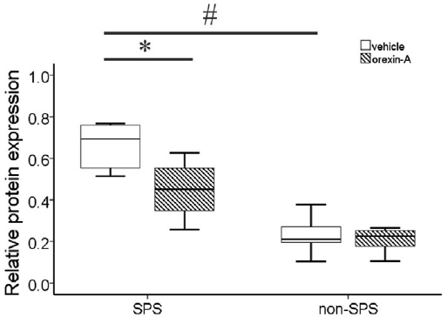
PTSD and Orexin
Orx_{A} effects oppose stress effects
Orx₂ decrease
Hippocampus
Orx₂
Notes:
stress (SPS) increased Orx2 protein in hippocampus (Fig. 7F#)
SPS+Veh > non-SPS+Veh
icvOrxA decreased Orx2 protein in hippocampus after stress (SPS) (Fig. 7F*)
SPS+Veh > SPS+OrxA

Slide 35
PTSD and Orexin
Stress impairs memory
By ↓Orx_{A}
Orx_{A} treatment:
Less/no impairment
Notes:
stress (SPS) decreased number of platform crossing (MWM) (Fig. 6C##)
SPS+Veh < non-SPS+Veh
icvOrxA increased number of platform crossings (MWM) after stress (SPS) (Fig. 6C*)
SPS+Veh < SPS+OrxA

Slide 36
PTSD and Orexin
Hypothalamus
PTSD: ↓Orx_{A}
↑Orx₁ not Orx₂
Different roles?
↑Orx_{A}: ↓Orx₁
Hippocampus
PTSD:
↑Orx₁ & ↑Orx₂
Similar roles?
↑Orx_{A}: ↓Orx₁, ↑Orx₁

Slide 37
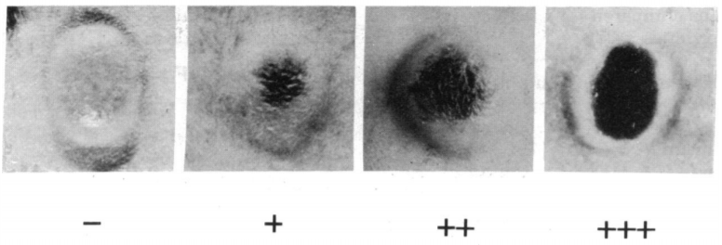
Tumor Necrosis Factor (TNF)
TNF-α
TNF superfamily: Fas ligand, Lymphotoxin alpha (TNF-β)
Cytokine – cell-signaling
Respond to trauma & infection
Originally – widespread death of transplanted sarcoma cells
Notes:
TNF superfamily – all have TNF homology & all form trimers

Slide 38
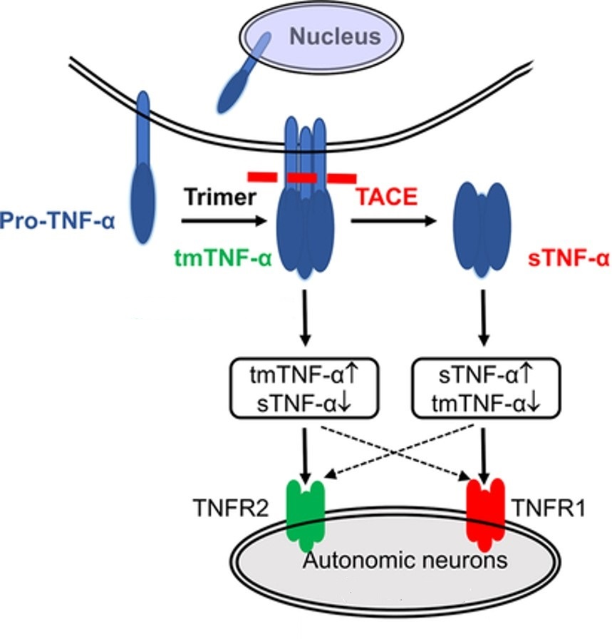
Tumor Necrosis Factor (TNF)
Microglia
Expressed by immune cells
Macrophages
Microglia – CNS
Transmembrane synthesis (tmTNF)
Enzymatic cleavage (TACE)
tmTNF & sTNF are active
Receptors: TNFR1 & TNFR2
Notes:
Can also be produced by other immune cells, and neurons

Slide 39
Tumor Necrosis Factor (TNF)
Regulatory roles
Sleep
Synaptic plasticity
Food & water intake
Learning & memory
Damaging roles
Large amounts
Upregulate Glu-Rs
Cachexia – “wasting”
Neuroinflammation
Neurological disease

Slide 40
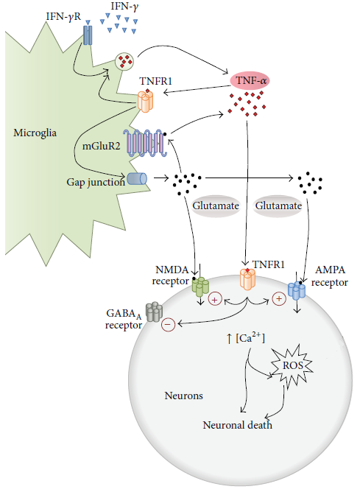
Tumor Necrosis Factor (TNF)
Damaging roles
Large amounts
Upregulate Glu-Rs
Cachexia – “wasting”
Neuroinflammation
Neurological disease
Expressed by immune cells
Microglia – M1
Notes:
Both receptors can induce cell death, but differently I think

Slide 41
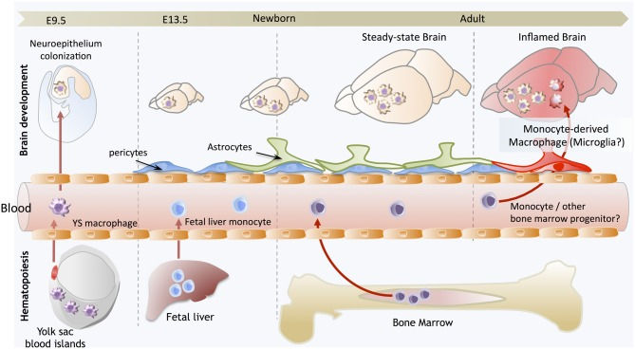
Microglia
CNS glial cell
Support neurons
Macrophage – immune cell
Protect & defend
Fixed Leukocyte
in tissue
M1: proinflammatory (TNF)
M2: anti-inflammatory

Slide 42
PTSD
TNF
Orx
Intrusion symptoms:
Memories
Dreams
Flashbacks
Reaction to Cues
Reactions to event:
Concentration problems
Sleep problems
Responds to:
Trauma
Roles:
Sleep
Food intake
Learning & Memory
Neurological disease
Involved in:
Stress
Feeding
Learning & Memory
Sleep
Notes:
Neurological disease like PTSD

Slide 43
PTSD
TNF
Orx
Intrusion symptoms:
Memories
Dreams
Flashbacks
Reaction to Cues
Reactions to event:
Concentration problems
Sleep problems
Responds to:
Trauma
Roles:
Sleep
Food intake
Learning & Memory
Neurological disease
Involved in:
Stress
Feeding
Learning & Memory
Sleep
Notes:
Neurological disease like PTSD

Slide 44
Prediction
Stress involves TNF and Orx to contribute to symptoms experienced in PTSD
If so, manipulation or intervention of interaction may lead to therapeutic treatments

Slide 45
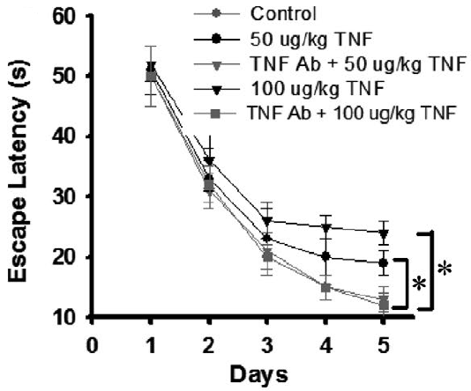
PTSD and TNF
TNF treatment impairs memory
like stress
high dose
opposed by neutralizing antibody (Ab)
Notes:
repeated high-dose TNFa increased escape latency (Fig. 7B)
Veh < 50 TNFa, Veh < 100 TNFa
TNFaAb decreased escape latency compared to repeated high-dose TNFa (Fig. 7B)
50 TNFa > 50 TNFa+TNFaAb, 100 TNFa > 100 TNFa+TNFaAb

Slide 46
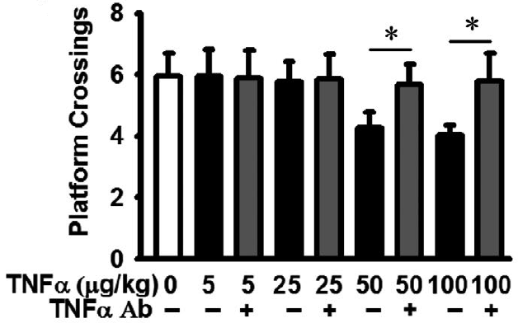
PTSD and TNF
TNF treatment impairs memory
like stress
high dose
opposed by neutralizing antibody (Ab)
Notes:
repeated high-dose TNFa decreased platform crossings (Fig. 7C)
Veh > 50 TNFa, Veh > 100 TNFa
TNFaAb increased platform crossings after repeated high-dose TNFa (Fig. 7C)
50 TNFa < 50 TNFa+Ab, 100 TNFa < 100 TNFa+Ab

Slide 47
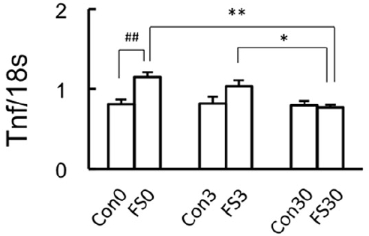
PTSD and TNF
Stress increases TNF mRNA
fear retention
whole brain microglia
Notes:
stress (FS) increased M1 TNF mRNA levels for fear retention (Fig. 2A)
Con0 < FS0, Con3 < FS3
long-duration re-exposure time decreased M1 TNF mRNA levels (Fig. 2A)
FS0 > FS30, FS3 > FS30

Slide 48
PTSD and TNF
Stress increases TNF mRNA
fear retention
hippocampus
Notes:
stress (FS) with fear retention (no re-exposure) increases number of cells with TNF in the hippocampus (Fig. 3A)
Con < FS0
more re-exposure time decreased number of cells with TNF in the hippocampus (Fig. 3A)
FS0 > FS30

Slide 49
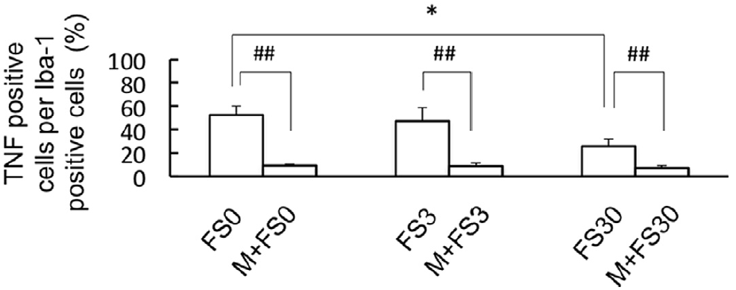
PTSD and TNF
Blocking M1 microglia reduces TNF
after stress
Notes:
long-duration re-exposure (fear extinction) decreased number of cells with TNF in the hippocampus (Fig. 5D)
S+FS0 > S+FS30
blocking M1 decreased number of cells with TNF in the hippocampus (Fig. 5D)
S+FS0 > M+FS0, S+FS3 > M+FS3, S+FS30 > M+FS30

Slide 50
Now we know…
PTSD & Orx, and PTSD & TNF are related
Stress
↓Orx_{A}, ↑orexin receptors,
↑TNF
Stress & TNF have similar behavioral effects
Impair memory – platform crossings
Opposed by treating molecular effect
What about TNF & Orx?
Notes:
“treating molecular effect” - providing more OrxA, or blocking TNF translation

Slide 51
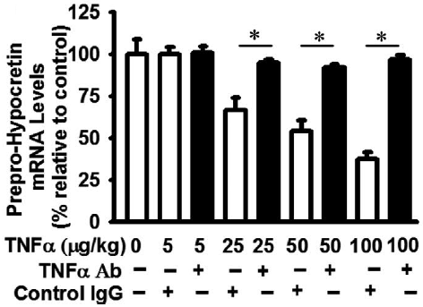
TNF & Orx
TNF decreases prepro-Orx mRNA
Hypothalamus
like stress
opposed by Ab
Notes:
TNFa decreased prepro-orexin mRNA levels in hypothalamus (Fig. 4G)
Veh = 5, Veh > 25, Veh > 50, Veh > 100, Veh > 200
TNFaAb before treatment increased prepro-orexin mRNA levels in hypothalamus after TNFa treatment (Fig. 5I)
5 TNFa+TNFaAb = TNFa+IgG, 25 TNFa+TNFaAb > TNFa+IgG, 50 TNFa+TNFaAb > TNFa+IgG, 100 TNFa+TNFaAb > TNFa+IgG

Slide 52
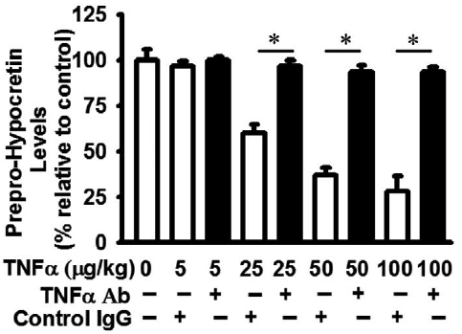
TNF & Orx
TNF decreases prepro-Orx protein
Hypothalamus
like stress
opposed by Ab
Notes:
TNFaAb increased prepro-orexin protein levels in hypothalamus after TNFa treatment (Fig. 5F)
5 TNFa+TNFaAb = TNFa+IgG, 25 TNFa+TNFaAb > TNFa+IgG, 50 TNFa+TNFaAb > TNFa+IgG, 100 TNFa+TNFaAb > TNFa+IgG

Slide 53
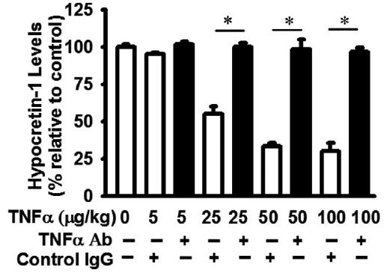
TNF & Orx
TNF decreases Orx_{A}
Hypothalamus
like stress
opposed by Ab
Notes:
TNFaAb increased OrxA protein levels in hypothalamus after TNFa treatment (Fig. 5G)
5 TNFa+TNFaAb = TNFa+IgG, 25 TNFa+TNFaAb > TNFa+IgG, 50 TNFa+TNFaAb > TNFa+IgG, 100 TNFa+TNFaAb > TNFa+IgG

Slide 54
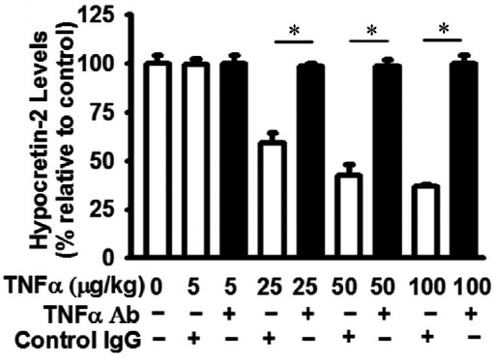
TNF & Orx
TNF decreases Orx_{B}
Hypothalamus
opposed by Ab
Notes:
TNFaAb before treatment increased OrxB protein levels in hypothalamus after TNFa treatment (Fig. 5H)
5 TNFa+TNFaAb = TNFa+IgG, 25 TNFa+TNFaAb > TNFa+IgG, 50 TNFa+TNFaAb > TNFa+IgG, 100 TNFa+TNFaAb > TNFa+IgG

Slide 55
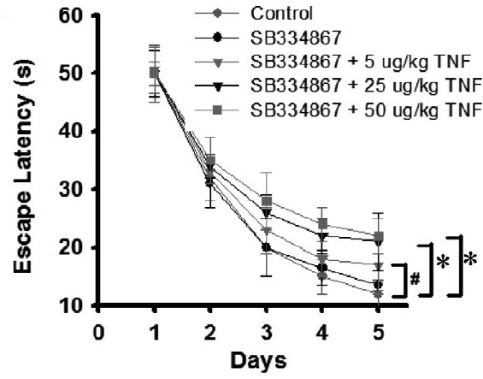
TNF & Orx
Blocking Orx₁ + TNF impairs memory
low dose TNF
Notes:
Orx1 antagonism with TNFa treatment increases escape latency (Fig. 7E)
Veh < SB+5TNFa, Veh < SB+25TNFa, Veh < 50TNFa

Slide 56
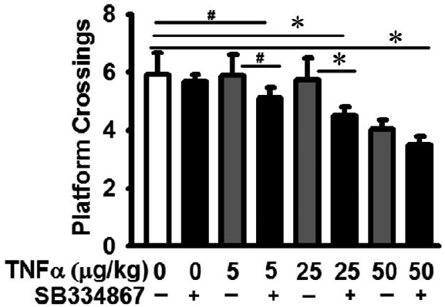
TNF & Orx
Blocking Orx₁ + TNF impairs memory
more intense than TNF
low dose TNF
Notes:
Orx1 antagonism with TNFa decreases platform crossing (Fig. 7F)
compared to vehicle
Veh > 5TNFa+SB, Veh > 25TNFa+SB, Veh > 50TNFa+SB
compared to just TNFa
5TNFa > 5TNFa+SB, 25TNFa > 25TNFa+SB

Slide 57
Summary
PTSD & Orx, and PTSD & TNF, are related
Stress: ↓Orx_{A}, ↑Orx-Rs, ↑TNF
Stress & TNF have similar behavioral effects
TNF has effects similar to stress on orexin
↓prepro-Orx, Orx_{A} (and Orx_{B})
TNF & Orx system contribute to PTSD

Slide 58
Conclusions
Changes in TNF expression as well as in the Orx system occur as a result of intense stress/trauma
Effects of stress are mirrored by TNF treatment
TNF & Orx function are altered in PTSD to create common symptoms; opposing those actions could be therapeutic
TNF: ↓Orx ligands
Ubiquitination?

Slide 59
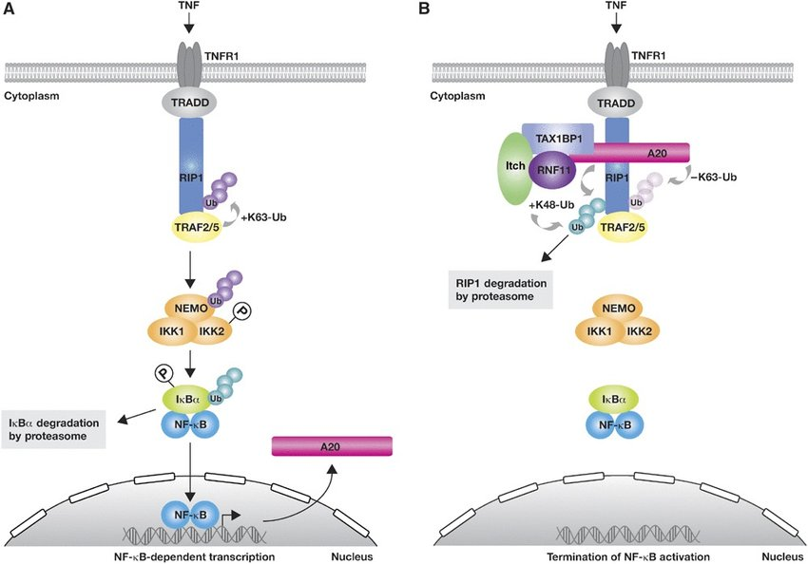
Possible Mechanism?
TNF & Orx
TNF-induced ubiquitination
TNFR1
Death domain
Degradation of proteins

Slide 60
End of slide show, click to exit.

Slide 61
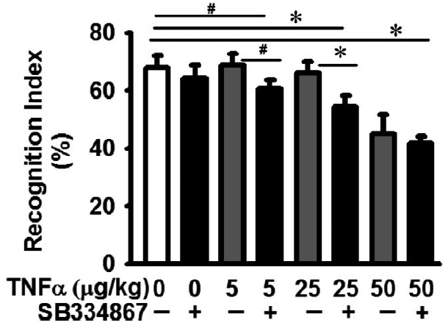
Novel Object Recognition

Slide 62
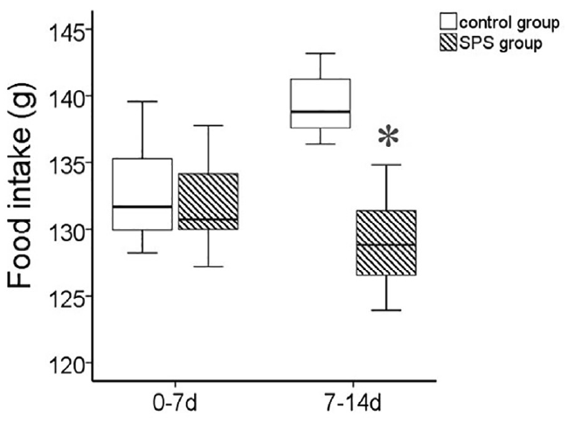
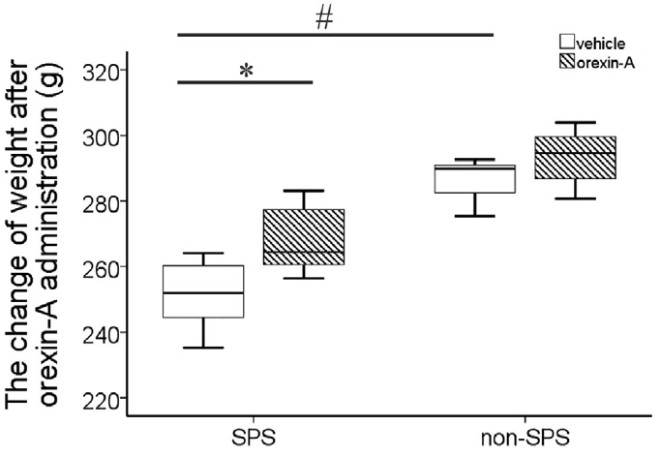
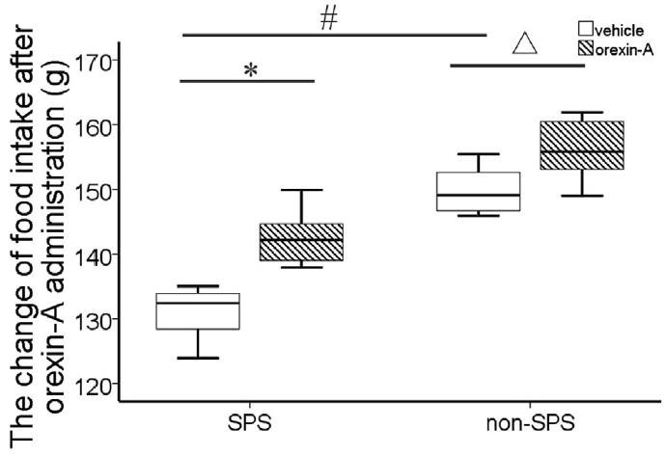
Body Growth & Food Intake

Slide 63
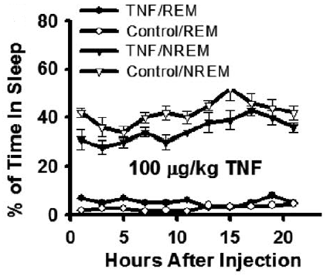
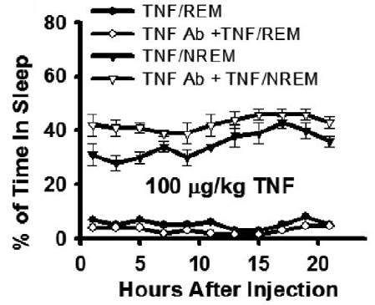
Sleep

Slide 64
Acute Predatory Stress (PS)
Hippocampus

